Slide 1
Greater Lincolnshire LEP
Water Management Plan
Water for Growth
Martin Collison
Collison and Associates Limited

Slide 2


Greater Lincolnshire: Unique elements
Notes:
MARK
In addition to a strong engineering, manufacturing and agricultural base we have a number of local strengths and are nationally important in terms of contributing to:
food security
manufacturing output
the UK visitor economy
our country’s housing needs

Slide 3
So why is the LEP interested in water?
  Local Enterprise Partnerships (LEPs) launched in 2010 to:
  Establish business led partnerships of industry & councils
  Drive economic growth via public & private investment
  Address barriers to growth e.g. transport, housing, digital
  LEPs have very modest budgets … but help direct the use of EU funding & investment in skills, transport & infrastructure
The focus is on GROWTH with the plan for the area set out in the Strategic Economic Plan – addressing water supply and flooding are important as enablers of growth

Slide 4
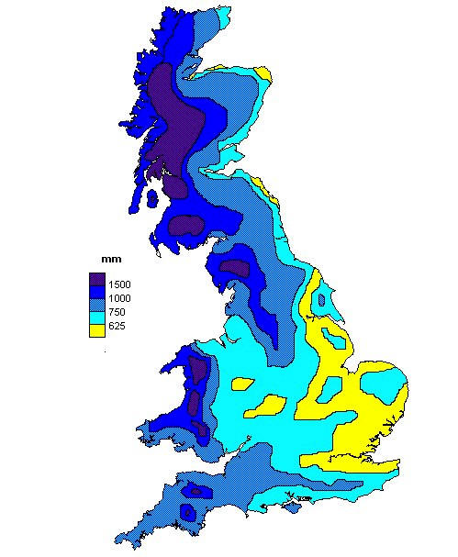
UK not short of water, but it is not where the population is … and Lincolnshire is amongst the driest areas ~ 600mm
We could move water, but this is expensive – capital, revenue & energy (CO₂), so it is only part of the solution
… also need to capture water naturally & store for later use
UK rainfall
Atmosphere, Climate and Environment Info Programme website, University of Manchester

Slide 5
GLLEP Water for Growth 25 Year Plan
Pressures on water are growing:
  Climate change, sea level rise, extreme rainfall events etc. - 45% of GLLEP is in the flood plain
  Growth & development are increasing demand for water
Existing solutions are not enough because:
  The magnitude of the challenge is growing
  The public sector/state cannot fund all the work needed
  New partnerships needed for collaborative solutions

Slide 6
GLLEP Water Plan – starting point
Multi-agency plan which focuses on:
Co-ordinating public & multi-sector private investment
Addressing water supply & flooding together
Long term challenge – 25 year plus, but need to set out clear short term actions (5-10 years) we can take now
Practical action & longer term innovation/research
Support for the major growth sectors in the GLLEP economy
Over 60 stakeholders were involved: industry, business groups, NGOs, Councils, Anglian Water, Environment Agency, IDBs, Flood Forums, LEP, University ….

Slide 7
GLLEP Strategic Economic Plan
The SEP focuses on growth in the area’s key economic growth sectors:
  Agri-food
  Visitor economy
  Manufacturing
  &
  Housing & infrastructure
Addressing flood risk & water supply essential to all these

Slide 8
Agri-Food Supply Chain
The food chain is more important in Greater Lincolnshire than the UK economy as a whole
The Greater Lincolnshire Agri-food sector has:
  101,000 employees (24% of the workforce)
  A GVA of £3.4bn (21% of the economy)
  10% of total English agricultural output (7% of UK total)
The GLLEP agri-food sector will double its contribution to the economy (GVA) by 2030 through investment in:
  Productive capacity, including water resources
  Skills & knowledge

Slide 9
Agri-food water demand
  The GFS programme reported in 2015 that the UK imports 38% of its food … but 62% of its food’s water footprint
  UK production is amongst the most water efficient in the World – typically a third or less of the water per tonne of crop harvested
  Very significant for fresh produce – to meet 365 day supply, UK imports from some of the most water stressed global locations ...
  …. this is not sustainable & securing UK water supplies for fresh produce increases UK economic output & is more sustainable
  We should not be seeking to reduce agri-food water use (as current policy does) but to increase supplies & use it more efficiently

Slide 10
Housing & Infrastructure
The GLLEP Strategic Economic Plan envisages:
  Council core strategies & LDFs set out plans for an additional 100,000 houses to be built by 2032
  100,000 extra homes mean a direct water demand increase of:
  12million cubic metres (tonnes) per year
NB In fact the actual figure is over 20x this with the embedded water in the products you consume

Slide 11
The Plan
  Investment in three key areas:
  Flood prevention
  Water supply - capture, storage & recycling
  Water management – R&D, awareness raising & skills
  Collaboration
  Public & private sector
  Multiple partners for flood schemes & water storage
  Government will not do it all for us – we need local action
  Policy changes and ‘freedoms & flexibilities’

Slide 12
Education research & training
R&D, training,
awareness raising
Water efficiency programme
Flood scheme R&D
New models of funding
Water Resources East Anglian
Demo projects
Link to wider Humber & Fens flood planning
Reservoirs, water capture & transport
Flood & water supply schemes
Flood schemes
Water for growth
Flood risk reduction

Slide 13
Delivering the Water for Growth Plan
Realities:
  We need additional business & land owner investment
  Businesses have lots of things they can invest in
  Many industries are mobile – both in the UK & globally
If we want them to invest in water the incentive framework & costs are critical, e.g.:
  If business invests in flood prevention it is tax deductible only if the EA also invests … why is this?
  Why invest in a reservoir which is not tax deductible whilst a tractor or packing line is?

Slide 14

Potential Support: Government
What government support is needed to deliver our Water for Growth Plan?
  Freedoms & flexibilities are key so we can try new local solutions
  Length of flood funding plans – 6 years is a good start … but needs to be 25year + to give certainty for investment
  Environment Agency, Growth Deal, RDPE, ERDF, Innovate UK etc. funding must be aligned with our water management needs
  Tax breaks for industry & communities to invest are essential if we want them to invest more
Notes:
MARTIN

Slide 15
Conclusions
Water supply & flooding are big challenges & will grow in importance due to growth & climate change
We have to adopt new solutions including:
  Raise awareness of water issues in communities & businesses
  Need to manage demand through water efficiency, but more water is needed to deliver growth targets inc. in agriculture
  Need to capture & store more water
  Flood risks need to be low enough to give investment certainty
  Fund flooding & water provision together where possible
  Regulatory change & stability to give confidence for investment

Slide 16
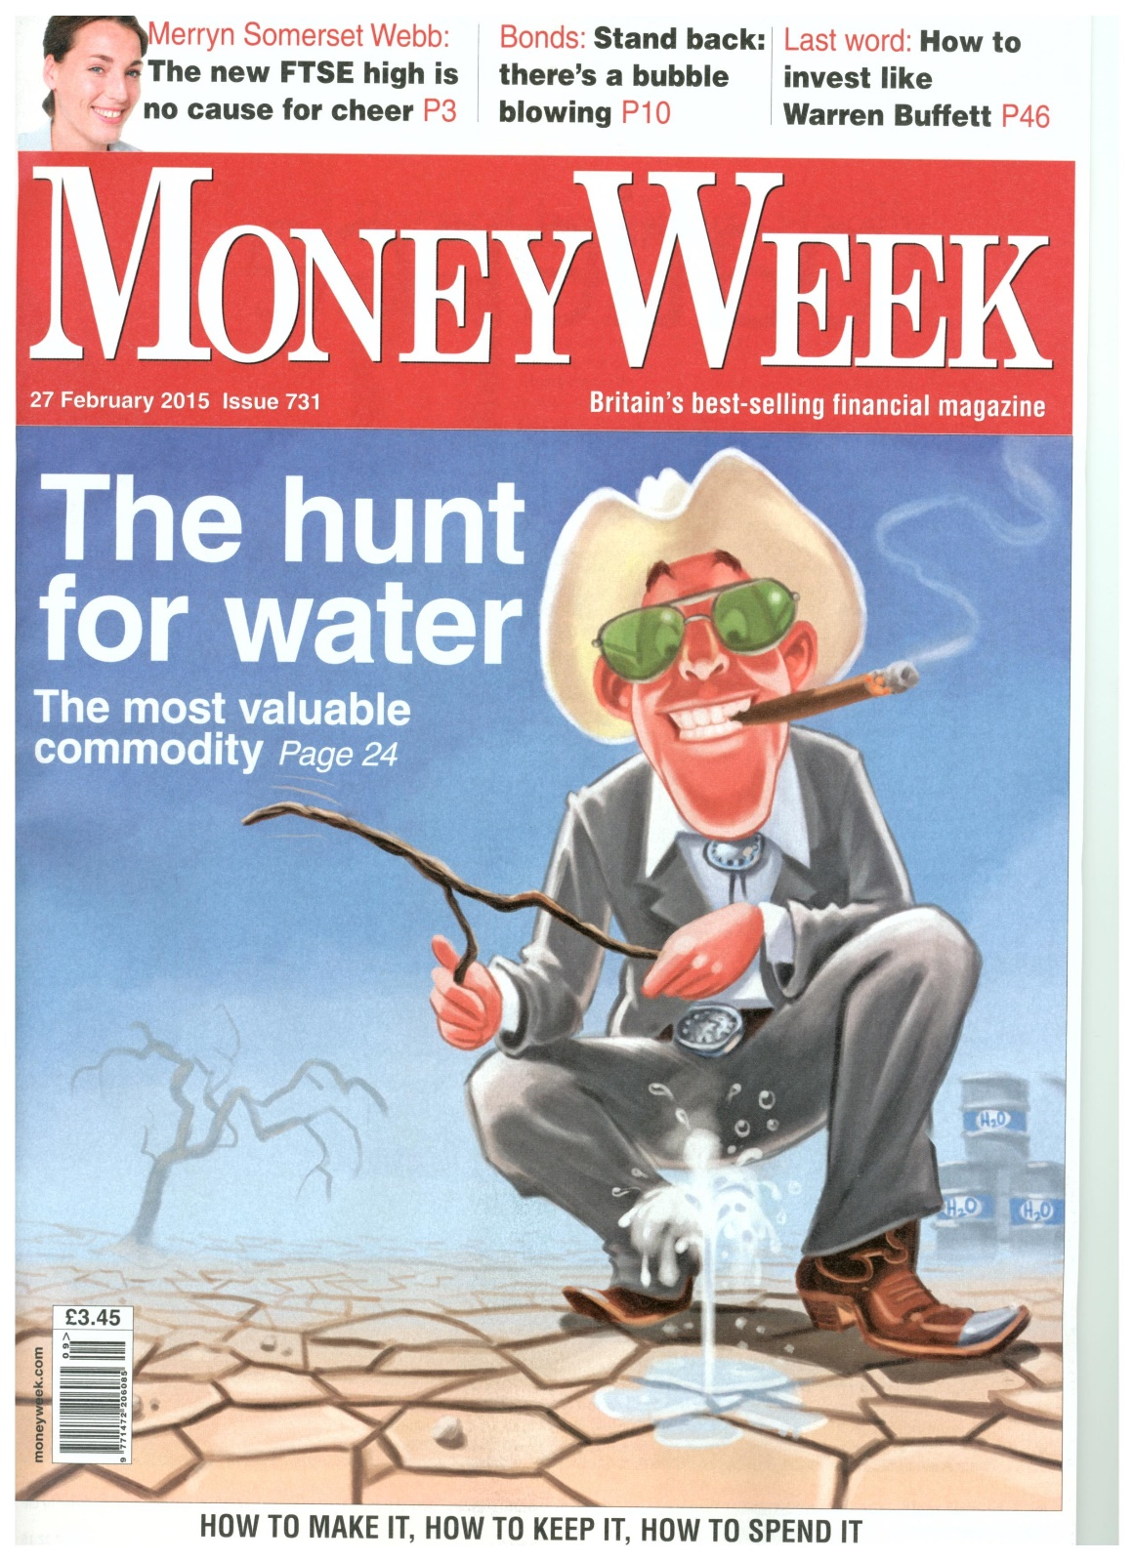
27th Feb 2015 MoneyWeek
Water … the most valuable commodity
.. when the money men arrive you are onto something

Slide 17

www.greaterlincolnshirelep.co.uk
gllepsecretariat@lincolnshire.gov.uk
martin@collisonassociates.co.uk

